Slide 1
Recursion
Lecture # 10

Slide 2
Recursion
Recursion is a process for solving problems by subdividing a larger problem into smaller cases of the problem itself and then solving the smaller, more trivial parts.
A function that calls itself is known as a recursive function.
All recursive solutions must satisfy three rules or properties:
A recursive solution must contain a base case.
A recursive solution must contain a recursive case.
A recursive solution must make progress toward the base case.

Slide 3
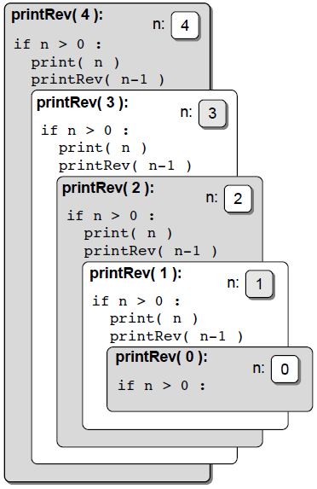
Recursion
def printRev( n ): if n > 0 : print( n ) printRev( n-1 )

Slide 4
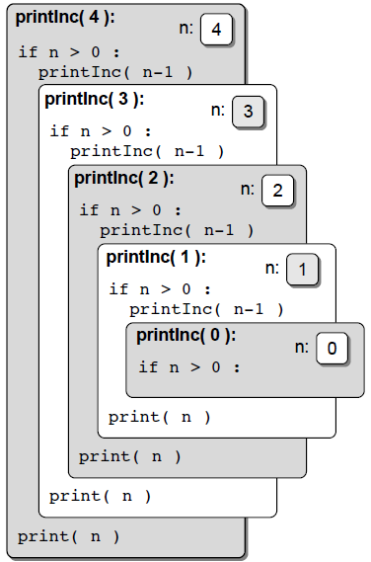
Recursion
def printInc( n ): if n > 0 : printInc( n-1 ) print( n )

Slide 5
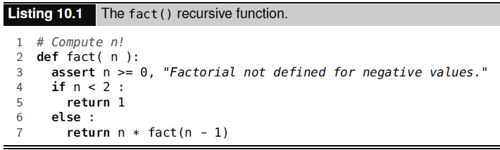
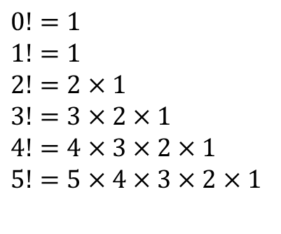
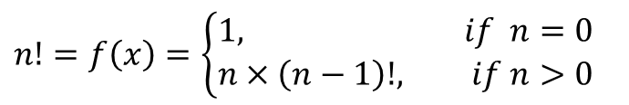
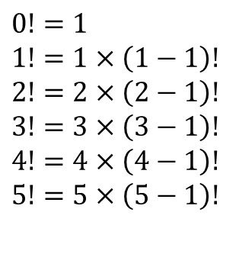
Factorials
$$n!=n×\left(n−1\right)×\left(n−2\right)×…×1$$
$$n!=f\left(x\right)=\left\{\begin{aligned}1, if n=0 \\ &n×\left(n−1\right)!, if n>0\end{aligned}\right.$$
$$0!=1$$
$$1!=1$$
$$2!=2×1$$
$$3!=3×2×1$$
$$4!=4×3×2×1$$
$$5!=5×4×3×2×1$$
$$0!=1$$
$$1!=1×\left(1−1\right)!$$
$$2!=2×\left(2−1\right)!$$
$$3!=3×\left(3−1\right)!$$
$$4!=4×\left(4−1\right)!$$
$$5!=5×\left(5−1\right)!$$

Slide 6
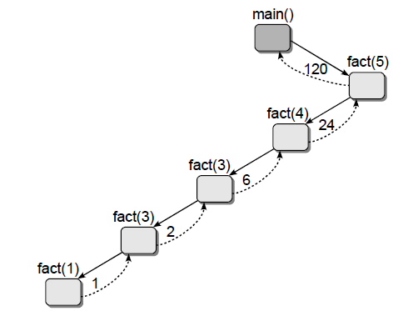
Factorials
(2)

Slide 7



The Fibonacci Sequence
The Fibonacci sequence is a sequence of integer values in which the first two values are both 1 and each subsequent value is the sum of the two previous values.
The $n^{th}$Fibonacci number can be computed by the recurrence relation (for n > 0):
$$0,1,1,2,3,5,8,13,21,34,55,89,…$$

Slide 8
The Fibonacci Sequence
def fact(n): assert n >= 0, "Fibonacci not defined for n < 1." if n<2: return n else: return fact(n-1)+fact(n-2)

Slide 9
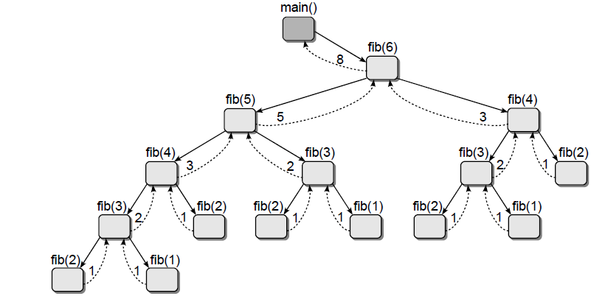
The Fibonacci Sequence

Slide 10
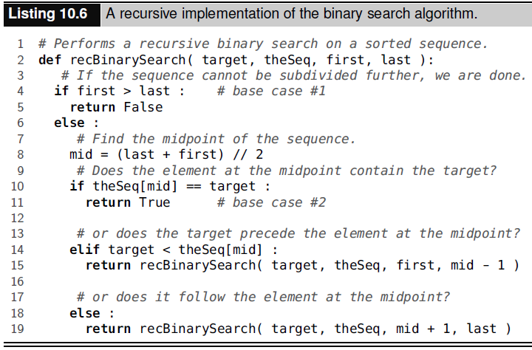
Recursive Binary Search

Slide 11
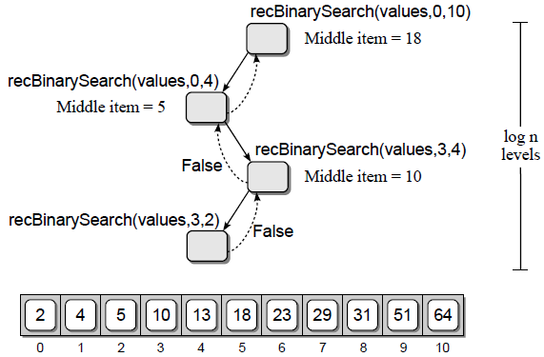
Recursive Binary Search
The recursive call tree for the binary search algorithm (top) when searching for value 8 in the given sequence (bottom).

Slide 12
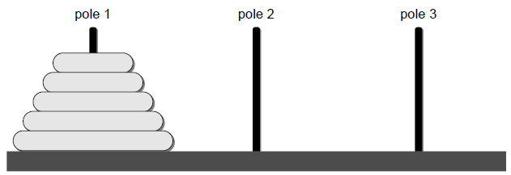
Towers of Hanoi
The Towers of Hanoi puzzle, consists of a board with three vertical poles and a stack of disks.
The objective is to move all of the disks from the starting pole to one of the other two poles to create a new tower. There are, however, two restrictions:
only one disk can be moved at a time, and
a larger disk can never be placed on top of a smaller disk.

Slide 13

Towers of Hanoi
Given n disks and three poles labeled source (S), destination (D), and intermediate (I), we can define the recursive operation as:
Move the top $n−1$ disks from pole S to pole I using pole D.
Move the remaining disk from pole S to pole D.
Move the $n−1$ disks from pole I to pole D using pole S.

Slide 14
Tower of Hanoi
Source
Destination
Intermediate

Slide 15
Tower of Hanoi
Source
Destination
Intermediate

Slide 16
Tower of Hanoi
Source
Destination
Intermediate

Slide 17
Tower of Hanoi
Source
Destination
Intermediate

Slide 18
Tower of Hanoi
Source
Destination
Intermediate

Slide 19
Tower of Hanoi
Source
Destination
Intermediate

Slide 20
Tower of Hanoi
Source
Destination
Intermediate

Slide 21
Tower of Hanoi
Source
Destination
Intermediate

Slide 22
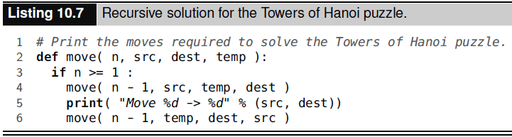
Tower of Hanoi

Slide 23
Tower of Hanoi – Output
move( 3, 1, 3, 2 )
Move 1 -> 3
Move 1 -> 2
Move 3 -> 2
Move 1 -> 3
Move 2 -> 1
Move 2 -> 3
Move 1 -> 3

Slide 24

Tower of Hanoi
1 disk → 1 move
2 disks → 3 moves
3 disks → 7 moves
4 disks → 15 moves
$n$ disks → $2^{n}−1$ moves

Slide 25
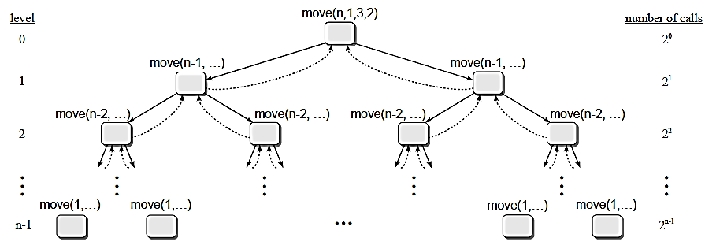
Tower of Hanoi

Slide 26
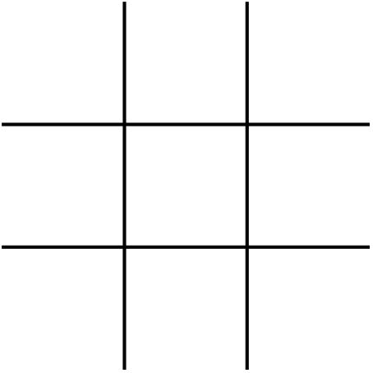
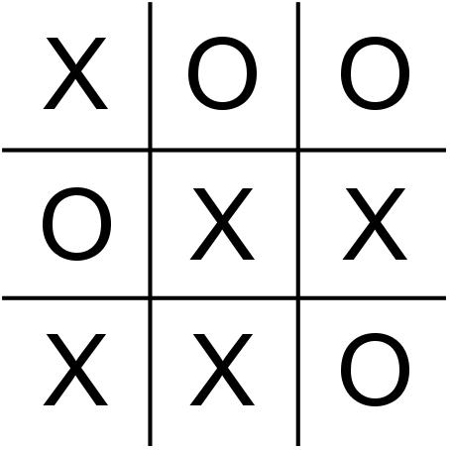
Playing Tic-Tac-Toe
Consider the game of tic-tac-toe
If you play tic-tac-toe against a computer, how does the computer make its decisions?

Slide 27
Game Tree
Provides the sequence of all possible moves that can be made in the game for both opponents.
The computer can evaluate the game tree and determine its best move.
For tic-tac-toe, the best move is one that
allows it to win before its opponent
in the fewest possible moves.
The “computer” can evaluate every possible move much faster than a human.

Slide 28
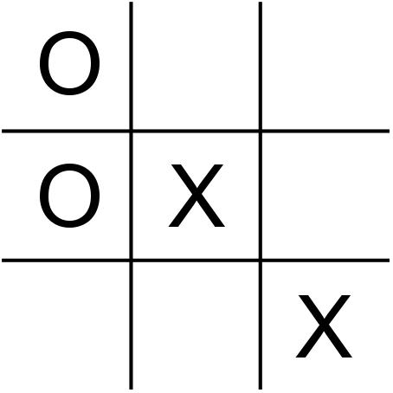
Game Tree Example
Suppose you (O) have been playing against the computer (X)
and now it's the computer's turn.

Slide 29
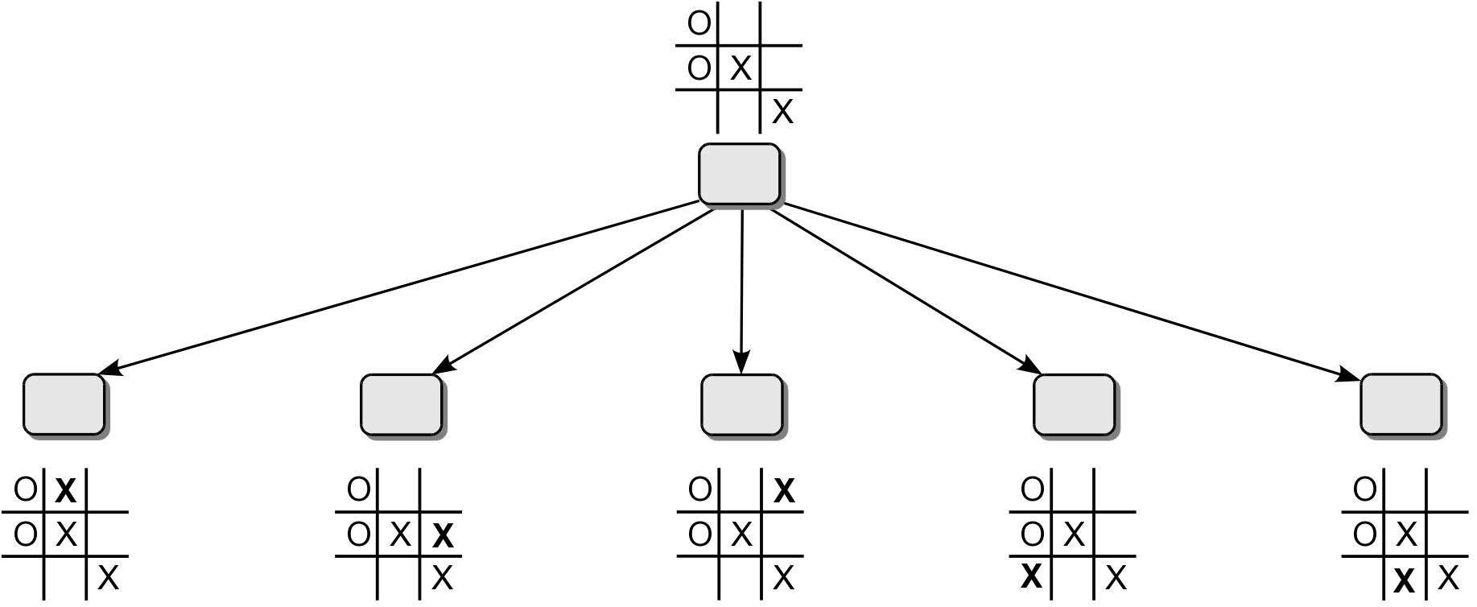
Game Tree Example
The computer would need to evaluate all of its possible moves to determine the best.

Slide 30
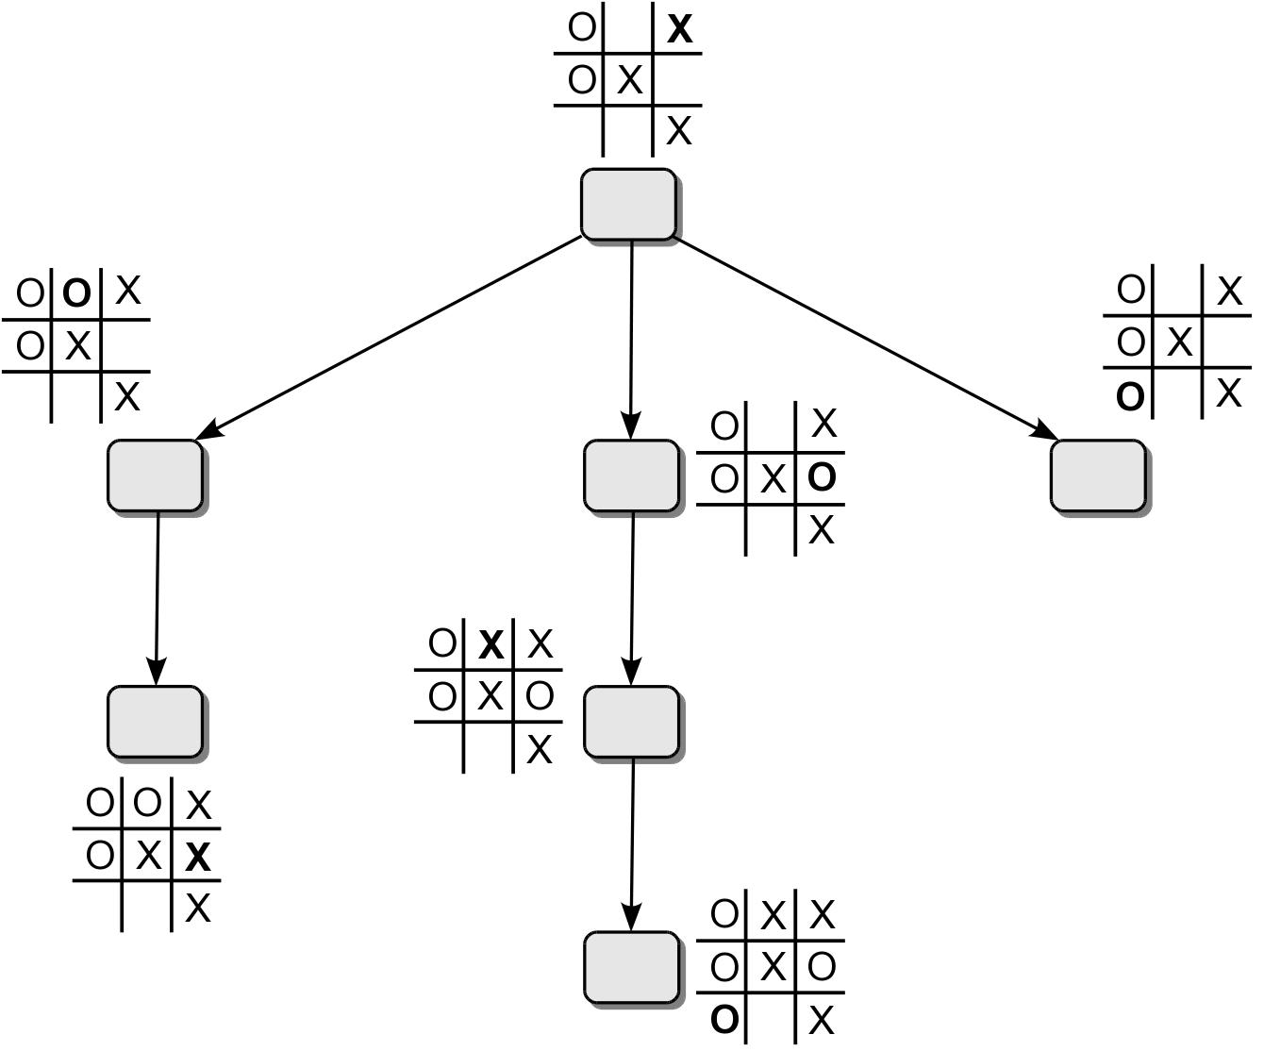
Game Tree Example
The following figure shows the rest of the tree for a movement in the upper-right square.

Slide 31
Game Tree Example
Assignment
Assignment should be solved using recursive technique.
Assignment should not be solved by using Minmax or Alpha-Beta pruning algorithm.
Submission Deadline : 15 January 2023 @11:59PM

Slide 32
The 8-Queens Problem
The task is to place 8 queens onto a chessboard such that no queen can attack another queen.
Uses a standard 8 x 8 chess board.
There are 92 solutions to this problem.

Slide 33
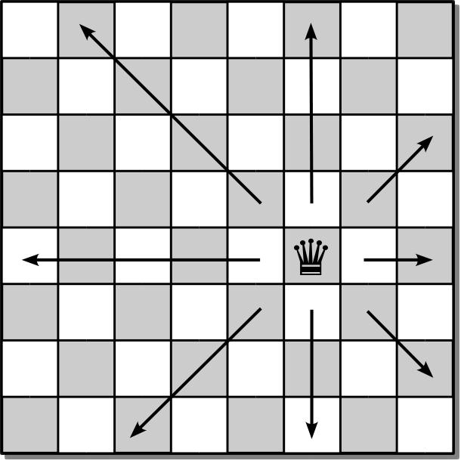
Queen Moves
The queen can move and attack any piece of the opponent by moving in any direction along a straight line.

Slide 34
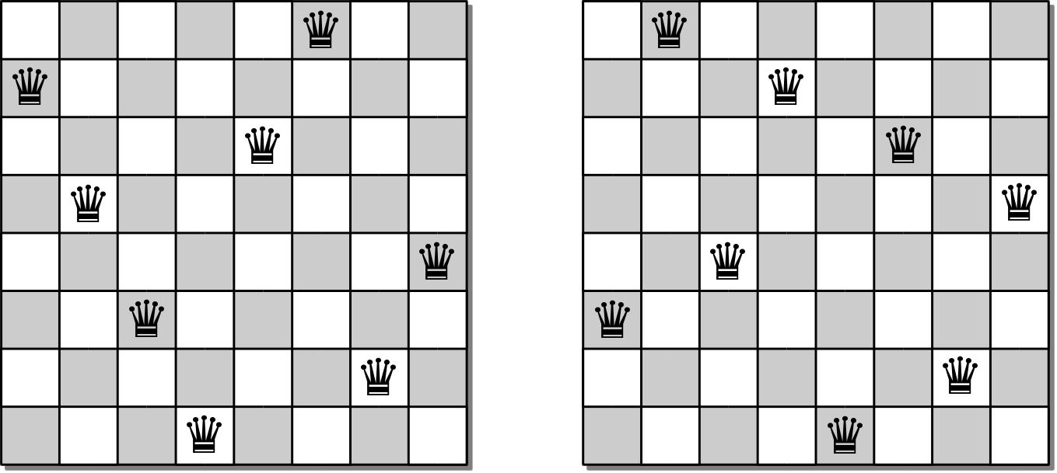
Sample Solutions

Slide 35
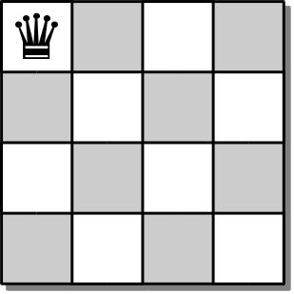
4-Queens Problem
To develop an algorithm, we consider the smaller 4-queens problem.
Since no two queens can occupy the same column, we can proceed one column at a time.
Place a queen in position (0, 0).

Slide 36
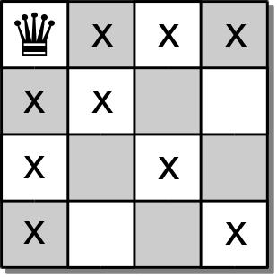
4-Queens Problem
This move eliminates a number of squares for the placement of additional queens.

Slide 37
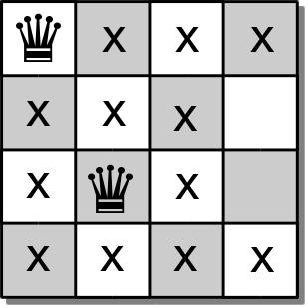
4-Queens Problem
We move to the second column and place a queen at position (2, 1)

Slide 38
4-Queens Problem
The 3rd queen should be placed in the 3rd column.
But there are no open cells in the third column.
So there is no solution based on the placement of the first 2 queens.

Slide 39
4-Queens Problem
We have to backtrack:
go back to the previous column
pickup the last queen placed
try to find another valid cell in that column.

Slide 40
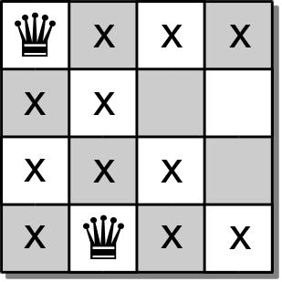
4-Queens Problem
Place a queen at position (3,1) and move forward.

Slide 41
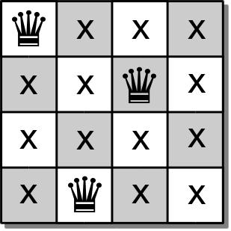
4-Queens Problem
In the 3rd column, we can now place a queen at position (1,2).
But now we have no open slots in the 4th column.

Slide 42
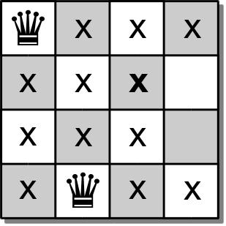
4-Queens Problem
We again must backtrack and pick up the queen from the 3rd column.
But there are no other empty cells in the 3rd column.

Slide 43
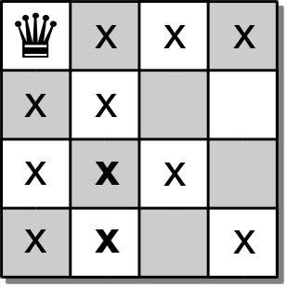
4-Queens Problem
We must backtrack yet again and pick up the queen from the 2rd column.
But there are no other empty cells in the 2nd column either.

Slide 44
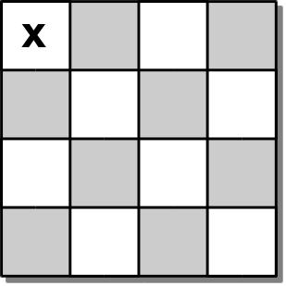
4-Queens Problem
So we backtrack one more time and pick up the queen from the 1st column.
We then try again to place a queen in the 1st column.

Slide 45
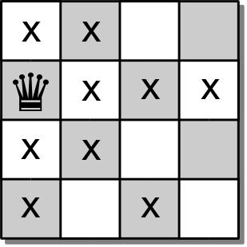
4-Queens Problem
In the 1st column, we can place a queen at position (1, 0).

Slide 46
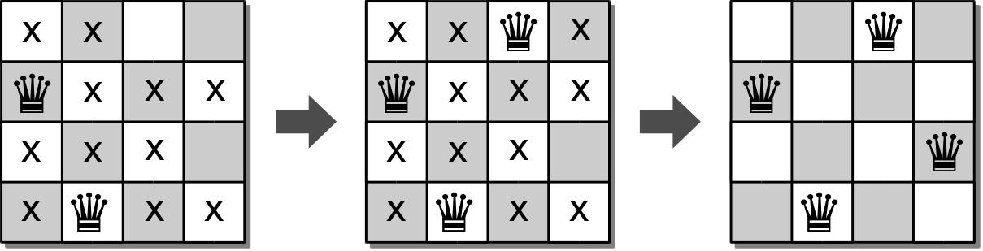
4-Queens Problem
We again continue with the process and attempt to find open positions in each of the remaining columns.
We can use a similar approach to solve the original 8-queens problem.

Slide 47
N-Queens Board ADT
The n-queens board is used for positioning queens on a square board for use in solving the n-queens problem.
consists of n x n squares.
each square is identified by index [0...n)
NQueensBoard( n ) size() numQueens() unguarded( row, col ) | placeQueen( row, col ) removeQueen( row, col ) reset() draw()

Slide 48
8-Queens Solution
def solveNQueens( board, col ):
if board.numQueens() == board.size() :
return True
else :
for row in range( board.size() ):
if board.unguarded( row, col ):
board.placeQueen( row, col )
if board.solveNQueens( board, col+1 ) :
return True
else :
board.removeQueen( row, col )
return False

